Slide 1

FOREIGN EXChANGE IMPORT COST ANALYSIS MADSC301 — Business Intelligence Term 3 — AY 2025/26 Final Assignment Lecturer: Hachem Sfar
Winnie Wambui Nduati
Student ID: 25058904

Slide 2
SYSTEM OVERVIEW
ExchangeRate API
↓
Python ETL Script
↓
PostgreSQL Database
↓
Power BI Dashboard
↓
Procurement Decision Making
Exchange rates are automatically extracted from ExchangeRate API, transformed using Python, stored in PostGreSQL, and visualized through Power BI dashboards.

Slide 3
DATA FLOW
Extract- Source data from ExchangeRate API using a unique API Key.
↓
Transform- Involves currency filtering, timestamp creation and data validation.
↓
Load- Clean data is loaded to a PostgreSQL table.
↓
Visualize- Power BI creates visuals.
This project follows a standard ETL architecture common in Business Intelligence systems.

Slide 4
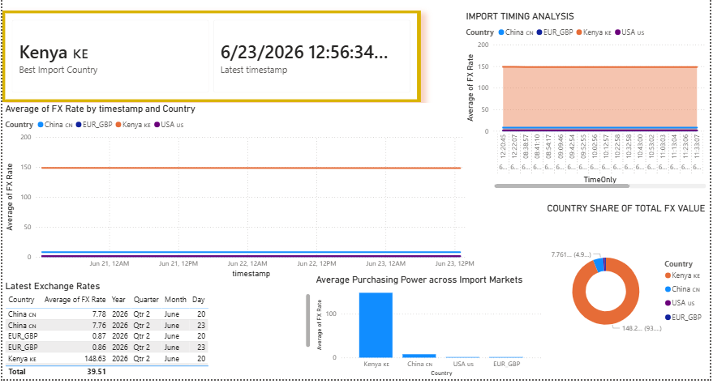
DASHBOARD INSIGHTS
Based on this exchange rate analysis, the company’s procurement division should schedule payments during periods of stronger EUR purchasing power.
The dashboard allows for continuous monitoring of the four currencies used; USD, GBP, CNY, and KES.

Slide 5
GitHub Repository
The complete project source code, Power BI dashboard, presentation slides, and supporting files are at https://github.com/winnienduati22-star/FX-Import-Analysis-BI-Project
Repository Contents
Python ETL Scripts (fx_rates_job.py and auto_fx_pipeline.py)
Power BI Dashboard (.pbix)
Project Architecture (.pbix)
Requirements File (.txt)
Project Documentation (README)

